Slide 1


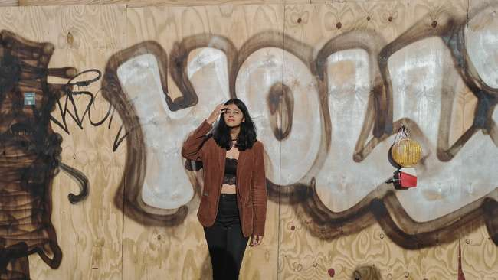

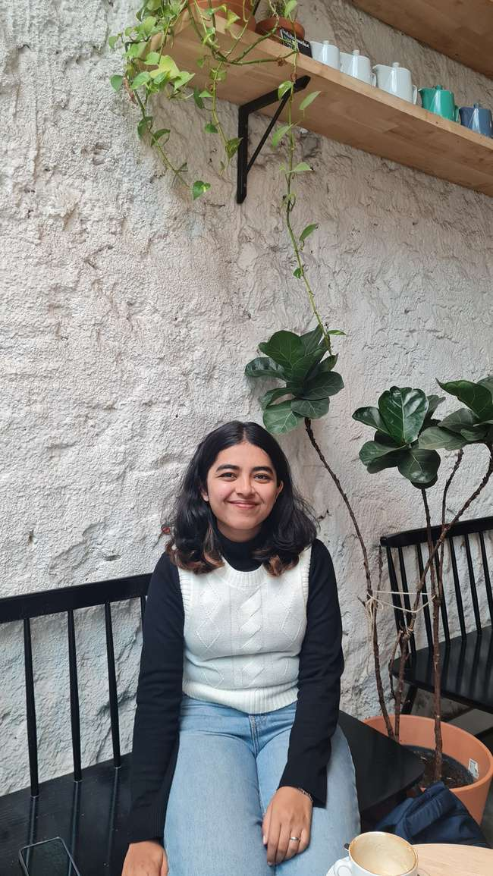
NOVA
BY
L’ORÉAL
SAKSHI
VINAYAK
SAI

Slide 2

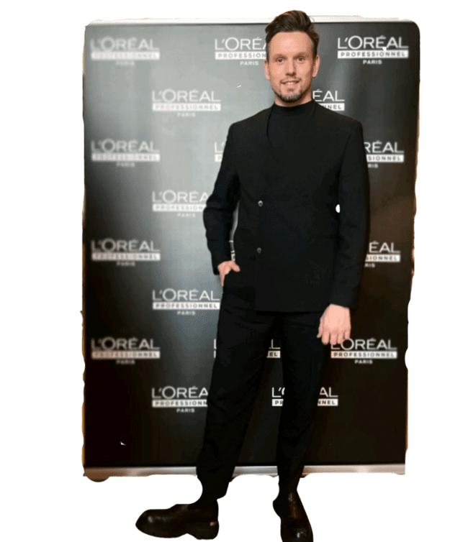




MEET DOMINIC
DILEMMA!!
L’oreal Professional Colour Expert

Slide 3
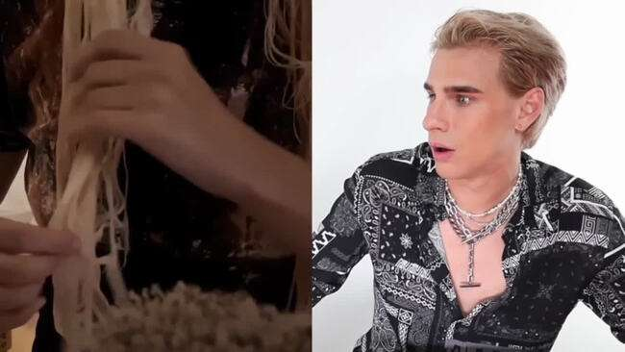

Slide 4


Slide 5
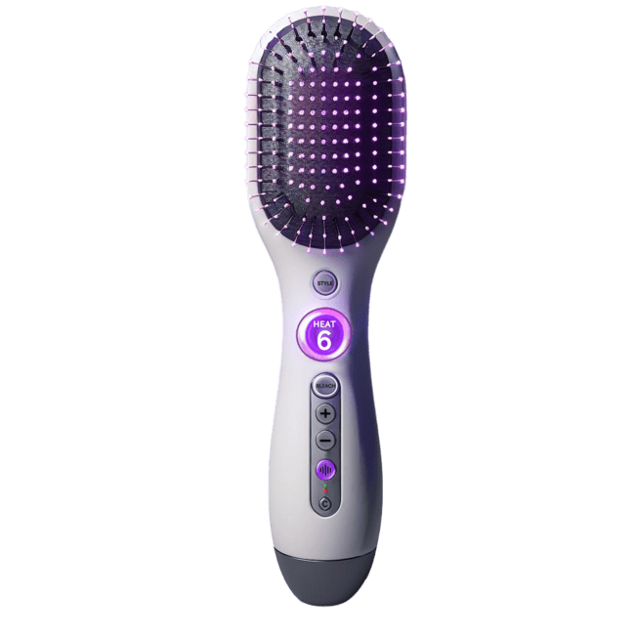
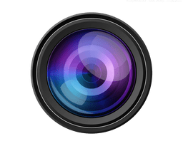

PRESENTING NOVA!
Pores on bristles to release bleach
Infrared light from the surface
Camera to detect hair characteristics
Heat intensity indicator
Voice assistant
Pop out Cartridge
NOVA
Cartridge

Slide 6






WHAT DOES NOVA DO?
Pores on bristles to release bleach
BLEACH
Infrared light from the surface
Camera to detect hair characteristics
Heat intensity indicator
STYLE
Voice assistant
Pop out Cartridge
NOVA
Cartridge

Slide 7










WHAT DOES NOVA DO?
Pores on bristles to release bleach
AI
Infrared light from the surface
Camera to detect hair characteristics
Heat intensity indicator
MOBILE APP
15:20
NOVA
Voice assistant
Dominic Vleer
+33 70 28 17 29 1
Number of strokes to do:
20
Maximum heat intensity
10
Pop out Cartridge
Suggested treatments: Smoothening
Hair length: Short
Hair Color: Brown
Hair texture: Dry
Previous Visits >
NOVA
Meetings
Community
Profile
Cartridge

Slide 8
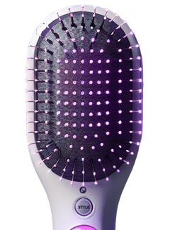

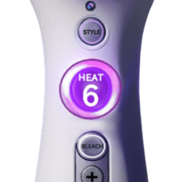


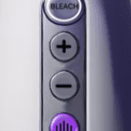
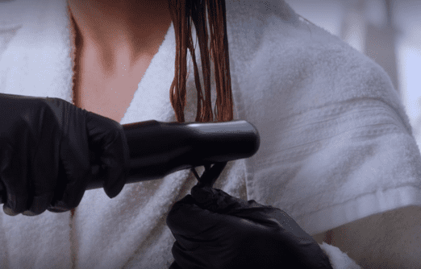
HOW DO YOU USE IT?
MODES
Enable the
bleach button
Set heat level as suggested by AI
BLEACH
Perform suggested number of strokes

Slide 9

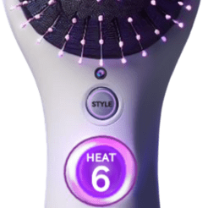

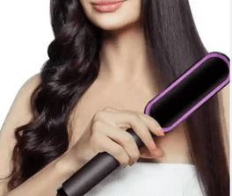
HOW DO YOU USE IT?
MODES
Enable the style button
Enable the
bleach button
Set heat level per AI suggestion.
Set heat level as suggested by AI
BLEACH
STYLE
Perform suggested number of strokes
Brush hair for desired style

Slide 10



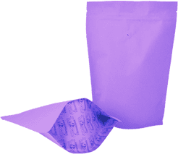


NOVA’S BUSINESS MODEL
SUSTAINABILITY
INCLUSIVITY
COMMUNITY
NOVA
BLEACH REFILL
BRAND
SCALABILITY

Slide 11
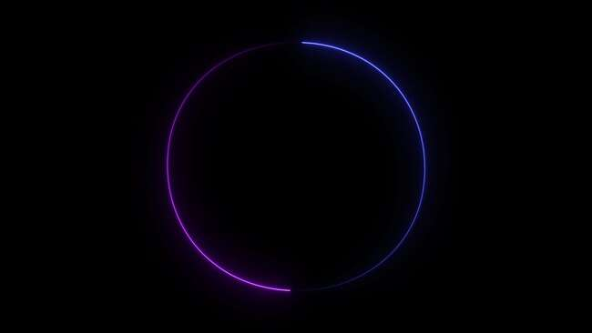
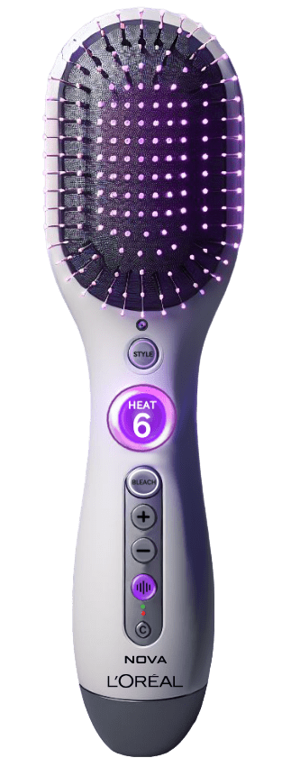
CREATE THE BEAUTY THAT MOVES THE WORLD
CHOOSE
NOVA

